Slide 1
In the name of God
Amebiasis
Dr.hamidreza sherkat alabasie

Slide 2
CLINICAL MANIFESTATIONS
Clinical presentations range from asymptomatic cyst passage to amebic colitis, amebic dysentery, ameboma, and extraintestinal disease. Up to 10% of infected persons develop invasive disease within a year, and asymptomatic carriers should be treated. Severe disease is more common in young children, pregnant women, malnourished individuals, and persons taking corticosteroids, and invasive disease is more common in men. Extraintestinal disease usually involves the liver, but less common extraintestinal manifestations include amebic brain abscess, pleuropulmonary disease, ulcerative skin, and genitourinary lesions.

Slide 4
DIAGNOSIS
A diagnosis of amebic colitis is made in the presence of compatible symptoms with detection of E. histolytica either by stool antigen testing or PCR. This approach has a greater than 95% sensitivity and specificity, and when it is coupled with a positive serology test, it is the most accurate means of diagnosis in developed countries. Several approved stool antigen kits are commercially available in the United States, but most cannot distinguish between E. histolytica and E. dispar. Microscopic examination of stool samples has a sensitivity of 60%. Sensitivity can be increased to 85–95% by examining three stools. Microscopy cannot differentiate between E. histolytica and E. dispar unless phagocytosed erythrocytes (specific for E. histolytica) are seen. Endoscopy and biopsies of suspicious areas should be performed when stool sample results are negative and suspicion remains high.

Slide 5
Various serum antibody tests are available. Serologic results are positive in 70–80% of patients with invasive disease (colitis or liver abscess) at presentation and in > 90% of patients after 7 days. The most sensitive serologic test, indirect hemagglutination, yields a positive result years after invasive infection. Therefore, many uninfected adults and children in highly endemic areas demonstrate antibodies to E. histolytica. Conventional and real-time multiplex PCR performed on stool is the most sensitive and preferred method for distinguishing

Slide 6
E.histolytica from nonpathogenic E. dispar and E. moshkovskii. Different multiplex formats have also been developed, including enteric pathogen panels with varying sensitivities and specificities. Isothermal nucleic acid methods using recombinase and loop-mediated amplification (LAMP) in point-of-care diagnostics are promising and will greatly facilitate treatment, especially in developing countries.

Slide 7
LABORATORY FINDINGS
Laboratory examination findings are often unremarkable in uncomplicated amebic colitis. Laboratory findings in amebic liver abscess are a slight leukocytosis, moderate anemia, high erythrocyte sedimentation rate, and elevations of hepatic enzyme (particularly alkaline phosphatase) levels. Stool examination for amebae is negative in more than half of patients with documented amebic liver abscess. Ultrasonography, CT, or MRI can localize and delineate the size of the abscess cavity . T he most common finding is a single abscess in the right hepatic lobe.

Slide 8
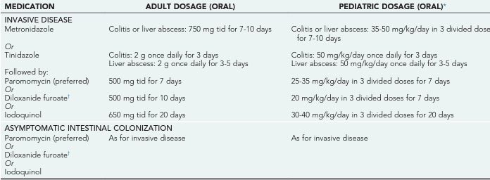
TREATMENT

Slide 9
Chloroquine phosphate (Aralen)
Chloroquine phosphate inhibits growth by concentrating within acid vesicles of the parasite, thereby increasing the organism's internal pH. It also inhibits the organism's hemoglobin utilization and metabolism.
n vitro studies involving trophozoites of E histolytica demonstrate that chloroquine possesses amebicidal activity comparable to that of emetine. It is highly effective in treating amebic liver abscess when administered with emetine or dehydroemetine; however, like emetine and dehydroemetine, it is not effective against luminal forms. Irreversible retinal damage does not occur with the dosage and treatment duration used for treatment of hepatic amebiasis.

Slide 10
Dehydroemetine (Mebadin)
Dehydroemetine is preferred to emetine because it is less toxic. It eradicates amebic tissue infections, including liver abscess, but does not act on luminal forms. To eradicate a bowel luminal infection, a luminal amebicide must be used as well. Dehydroemetine is effective only against trophozoites, not against cysts. In the United States, it is available only from the Parasitic Disease Drug Service of the Centers for Disease Control and Prevention (CDC).

Slide 11
Thanks for attention

